Slide 1
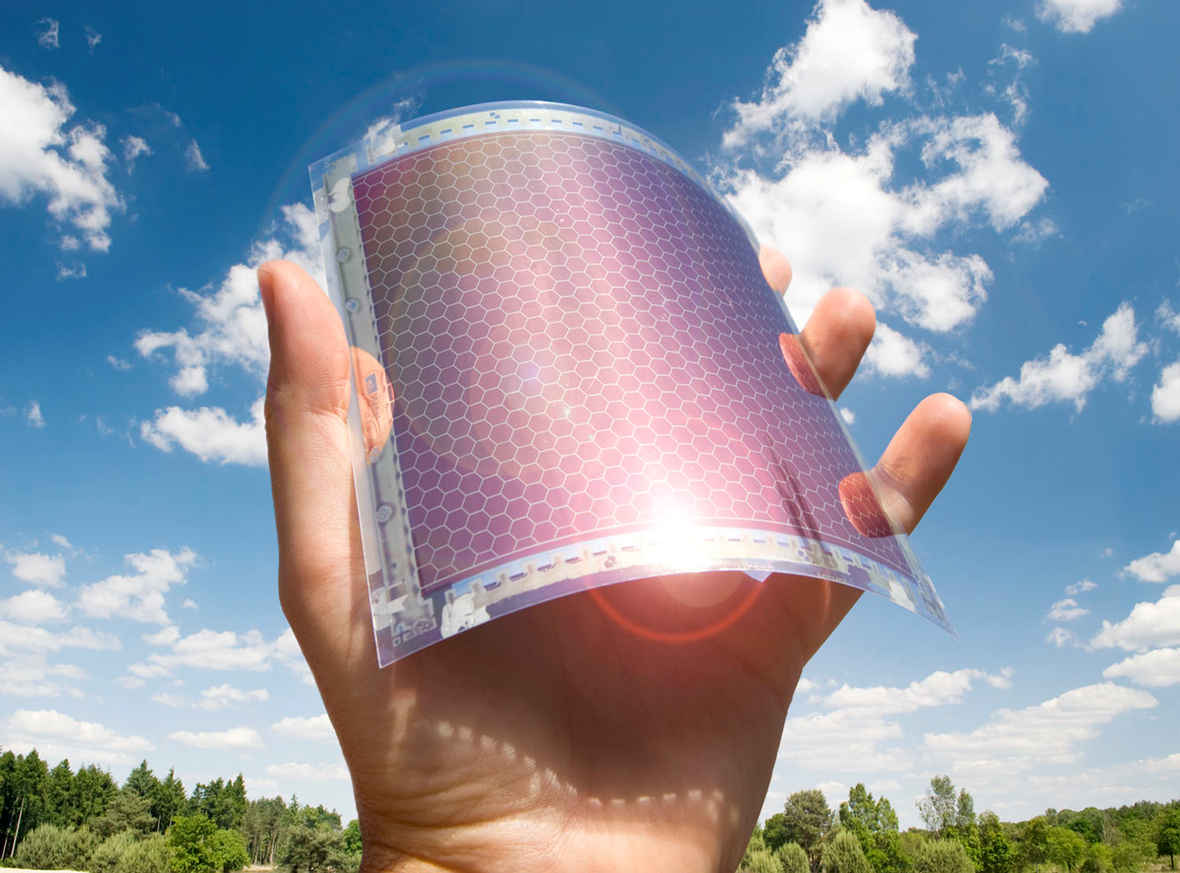
Murphy Project: Organic Photovoltaics Fabrication
Laura Pettersen
Hersam Lab
Notes:
Explain OPVs

Slide 2
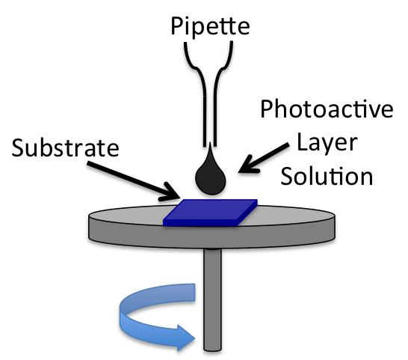
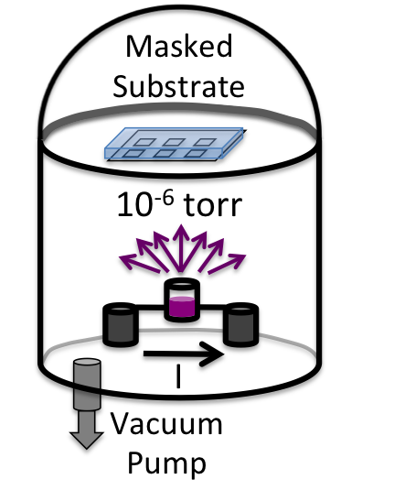
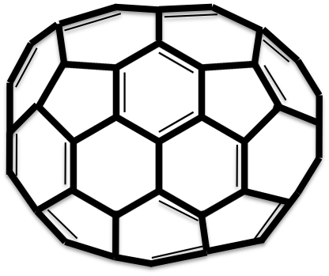
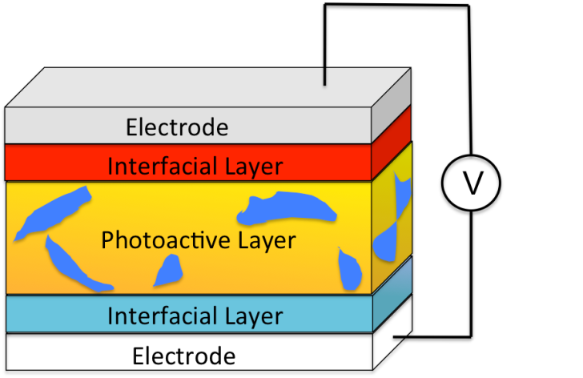
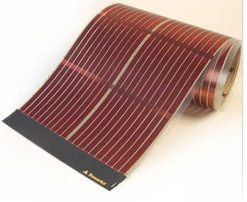
OPVs
Materials
Spin Coating
Vacuum Thermal Evaporation
PTB7
R = 2-ethylhexyl
PC₇₁BM
Flexible Substrates
OPV Device
renewableenergyworld.com
Inexpensive materials, device fabrication via solution processable techniques
D. Ginley, M. A. Green and R. Collins, MRS Bull., 2008, 33, 355-364.
Notes:
Use OPV device to show various aspects of the cell, explain spin coating, vacuum thermal evaporation

Slide 3
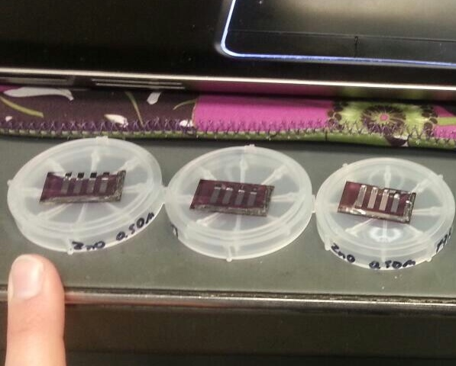
Steps in Making OPVs
Make interfacial layer and active layer solutions
Clean the ITO (transparent cathode) via sonication and O2 plasma
Spin coat on IFL and AL
Vacuum filtrate IFL and metal anode on
Encapsulate the cells
Test
Notes:
Go through the steps of how you make one of these cells and use the picture to help explain and show the scale.

